Slide 1
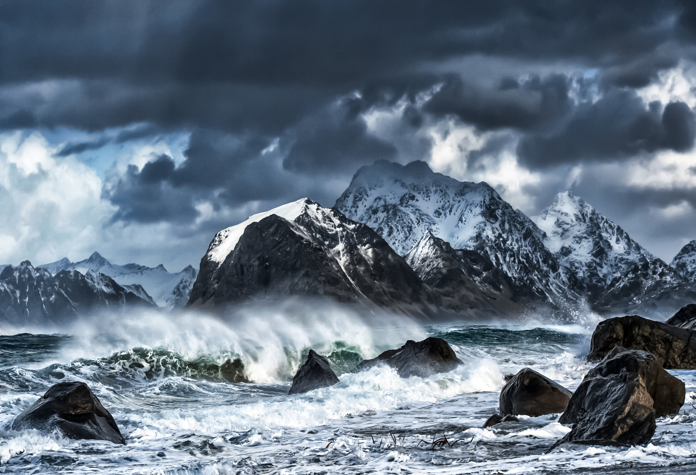

PREDATORS
a dedicated group of innovators focused on tackling climate change through impactful website solutions

Slide 2

TEAM
NITHIN JACOB
ABHISHEK JOJI
AMAN MATHEW JOSEPH
CYRIL JOSEPH
BISMI A
PARVATHY RAJEEV

Slide 3
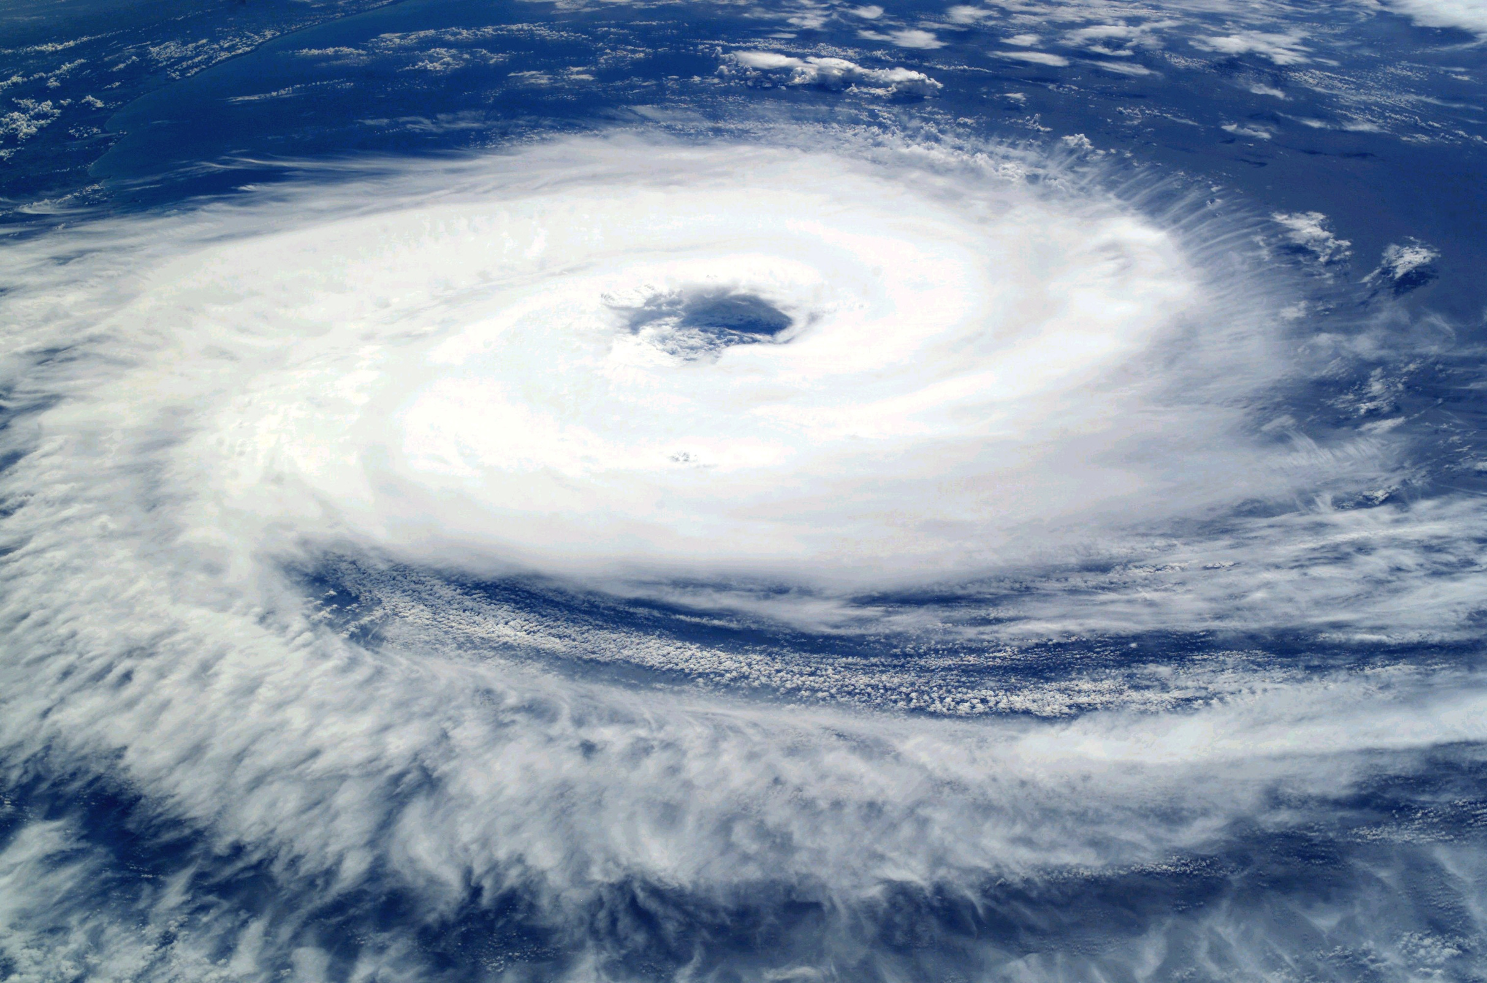
INTRODUCTION
Climate change demands urgent action, and access to real-time, reliable data is key. Our platform uses data from the U.S. Greenhouse Gas Center and other sources to provide actionable insights, helping users—from citizens to policymakers—understand and address climate change. By simplifying complex data, we empower informed actions that reduce carbon footprints and drive policy change.

Slide 4
FUNCTION
1
2
3
Awareness and Education
Adaptation and Resilience
Empowerment

Slide 5
The Alarming Trends: Observing Climate Change Indicators
Rising Temperatures:
Average global temperatures have increased significantly since the pre-industrial era.
Melting Glaciers:
Glacial ice is melting at an accelerating rate, contributing to rising sea levels.
Expansion of ocean water due to warming and melting ice sheets is leading to higher sea levels.
Extreme Weather Events:
Heatwaves, droughts, floods, and storms are becoming more frequent and intense.

Slide 6
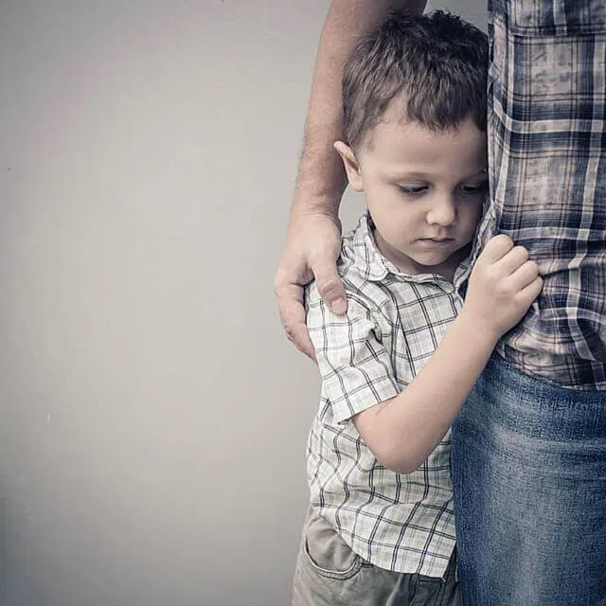
“a new dawn for aadi”

Slide 7
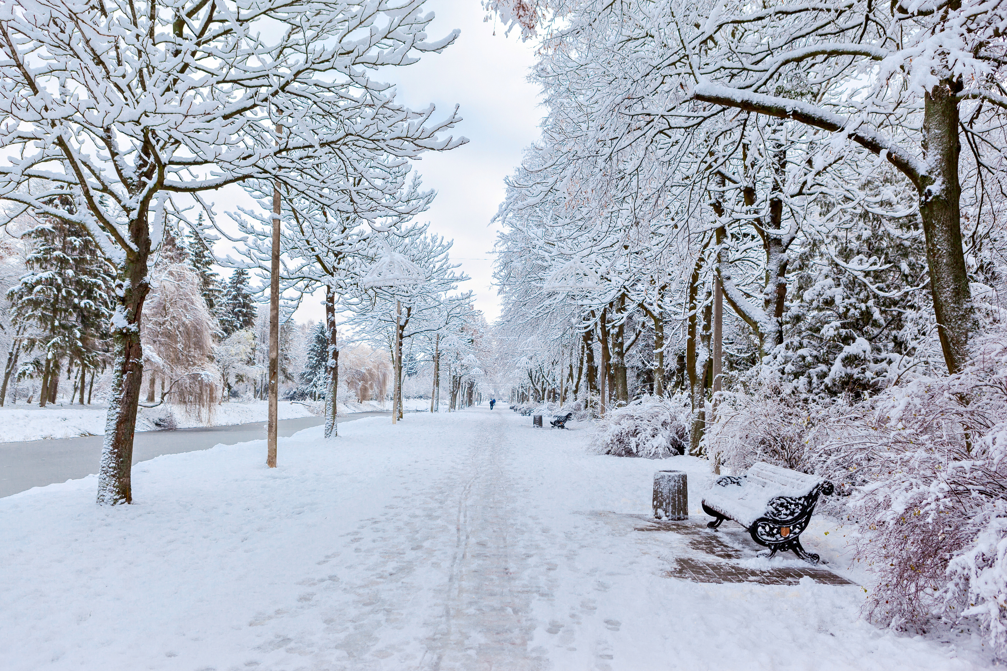
CLIMATE STORY
Once upon a time, in a small village by a river, there lived a boy named Aadi with his parents. They were a happy family, tending to their small farm and living peacefully. But one fateful night, heavy rains began to pour. The river, which had always been gentle, swelled into a raging force. The floodwaters rose quickly, sweeping away homes, trees, and everything in their path.
Aadi’s parents, trying to save him, pushed him onto a raft made from a broken door.

Slide 8
CLIMATE STORY
As the waters carried him away, he called out for them, but the flood had already separated them. Days passed, and Aadi found himself in a distant village, alone and heartbroken.
A kind old fisherman named Kiran found Aadi by the riverbank, weak and lost. He took the boy in, gave him food, shelter, and even began teaching him how to fish. Though Aadi missed his parents dearly, Kiran’s warmth and wisdom gave him strength. Over time, Aadi learned to live with the pain, finding solace in the river that once brought him sorrow.

Slide 9
CLIMATE STORY
Months later, while fishing on the riverbank, Aadi noticed a small boat coming towards him. As it approached, he saw two familiar faces—his parents, alive and well! They had survived the flood and spent months searching for him. With tearful eyes and open arms, they reunited in a joyous embrace.
Together, they thanked Kiran for his kindness, and the family rebuilt their lives, stronger than ever. Though they had lost much, they had found each other again, and that was all that mattered.
And from that day on, the river, once feared, became a symbol of hope and reunion for Aadi and his family.

Slide 10
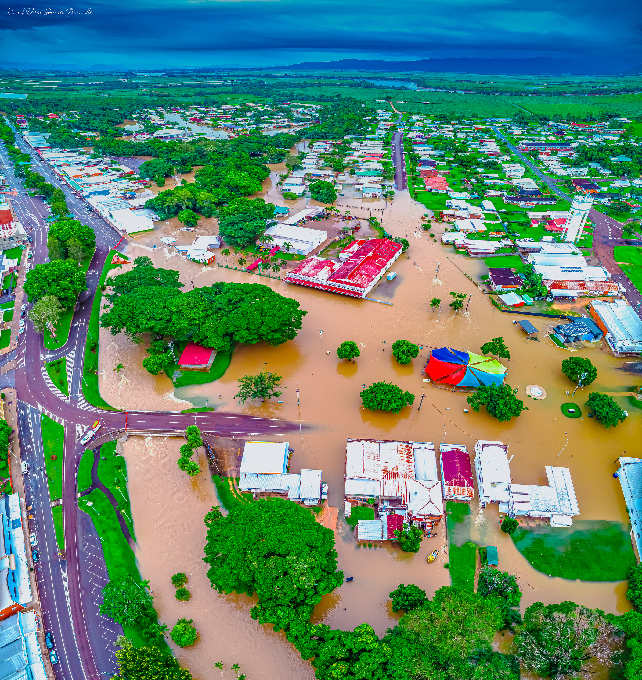
WELCOME TO CLIMATE
INSIGHTS PLATFORM
In an age where climate change is one of the most pressing challenges facing our planet, Climate Insights Platform is dedicated to empowering individuals and communities with the knowledge and tools necessary to understand and combat environmental issues.

Slide 11
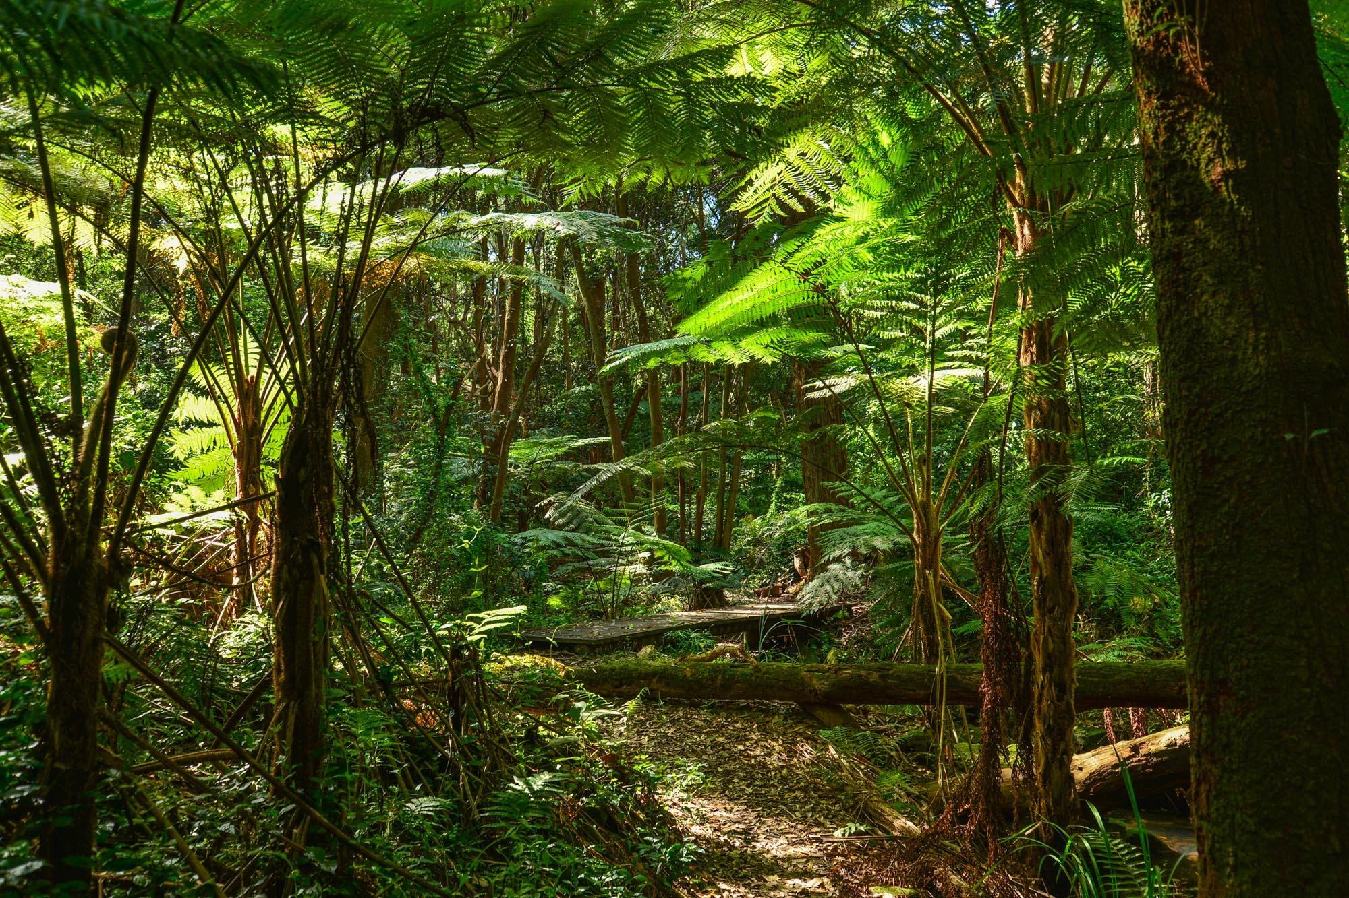
OUR MISSION
We aim to provide users with:
Real-time Data: Access to up-to-date information on global temperatures, CO₂ levels, and climate trends.
Interactive Tools: Utilize our predictive models to assess climate impacts based on different environmental factors.
Personalized Footprint Tracking: Calculate and track your carbon footprint through our comprehensive footprint tracker, helping you understand your impact on the environment.
Community Engagement: Join a community of like-minded individuals committed to sustainability and climate action.

Slide 12
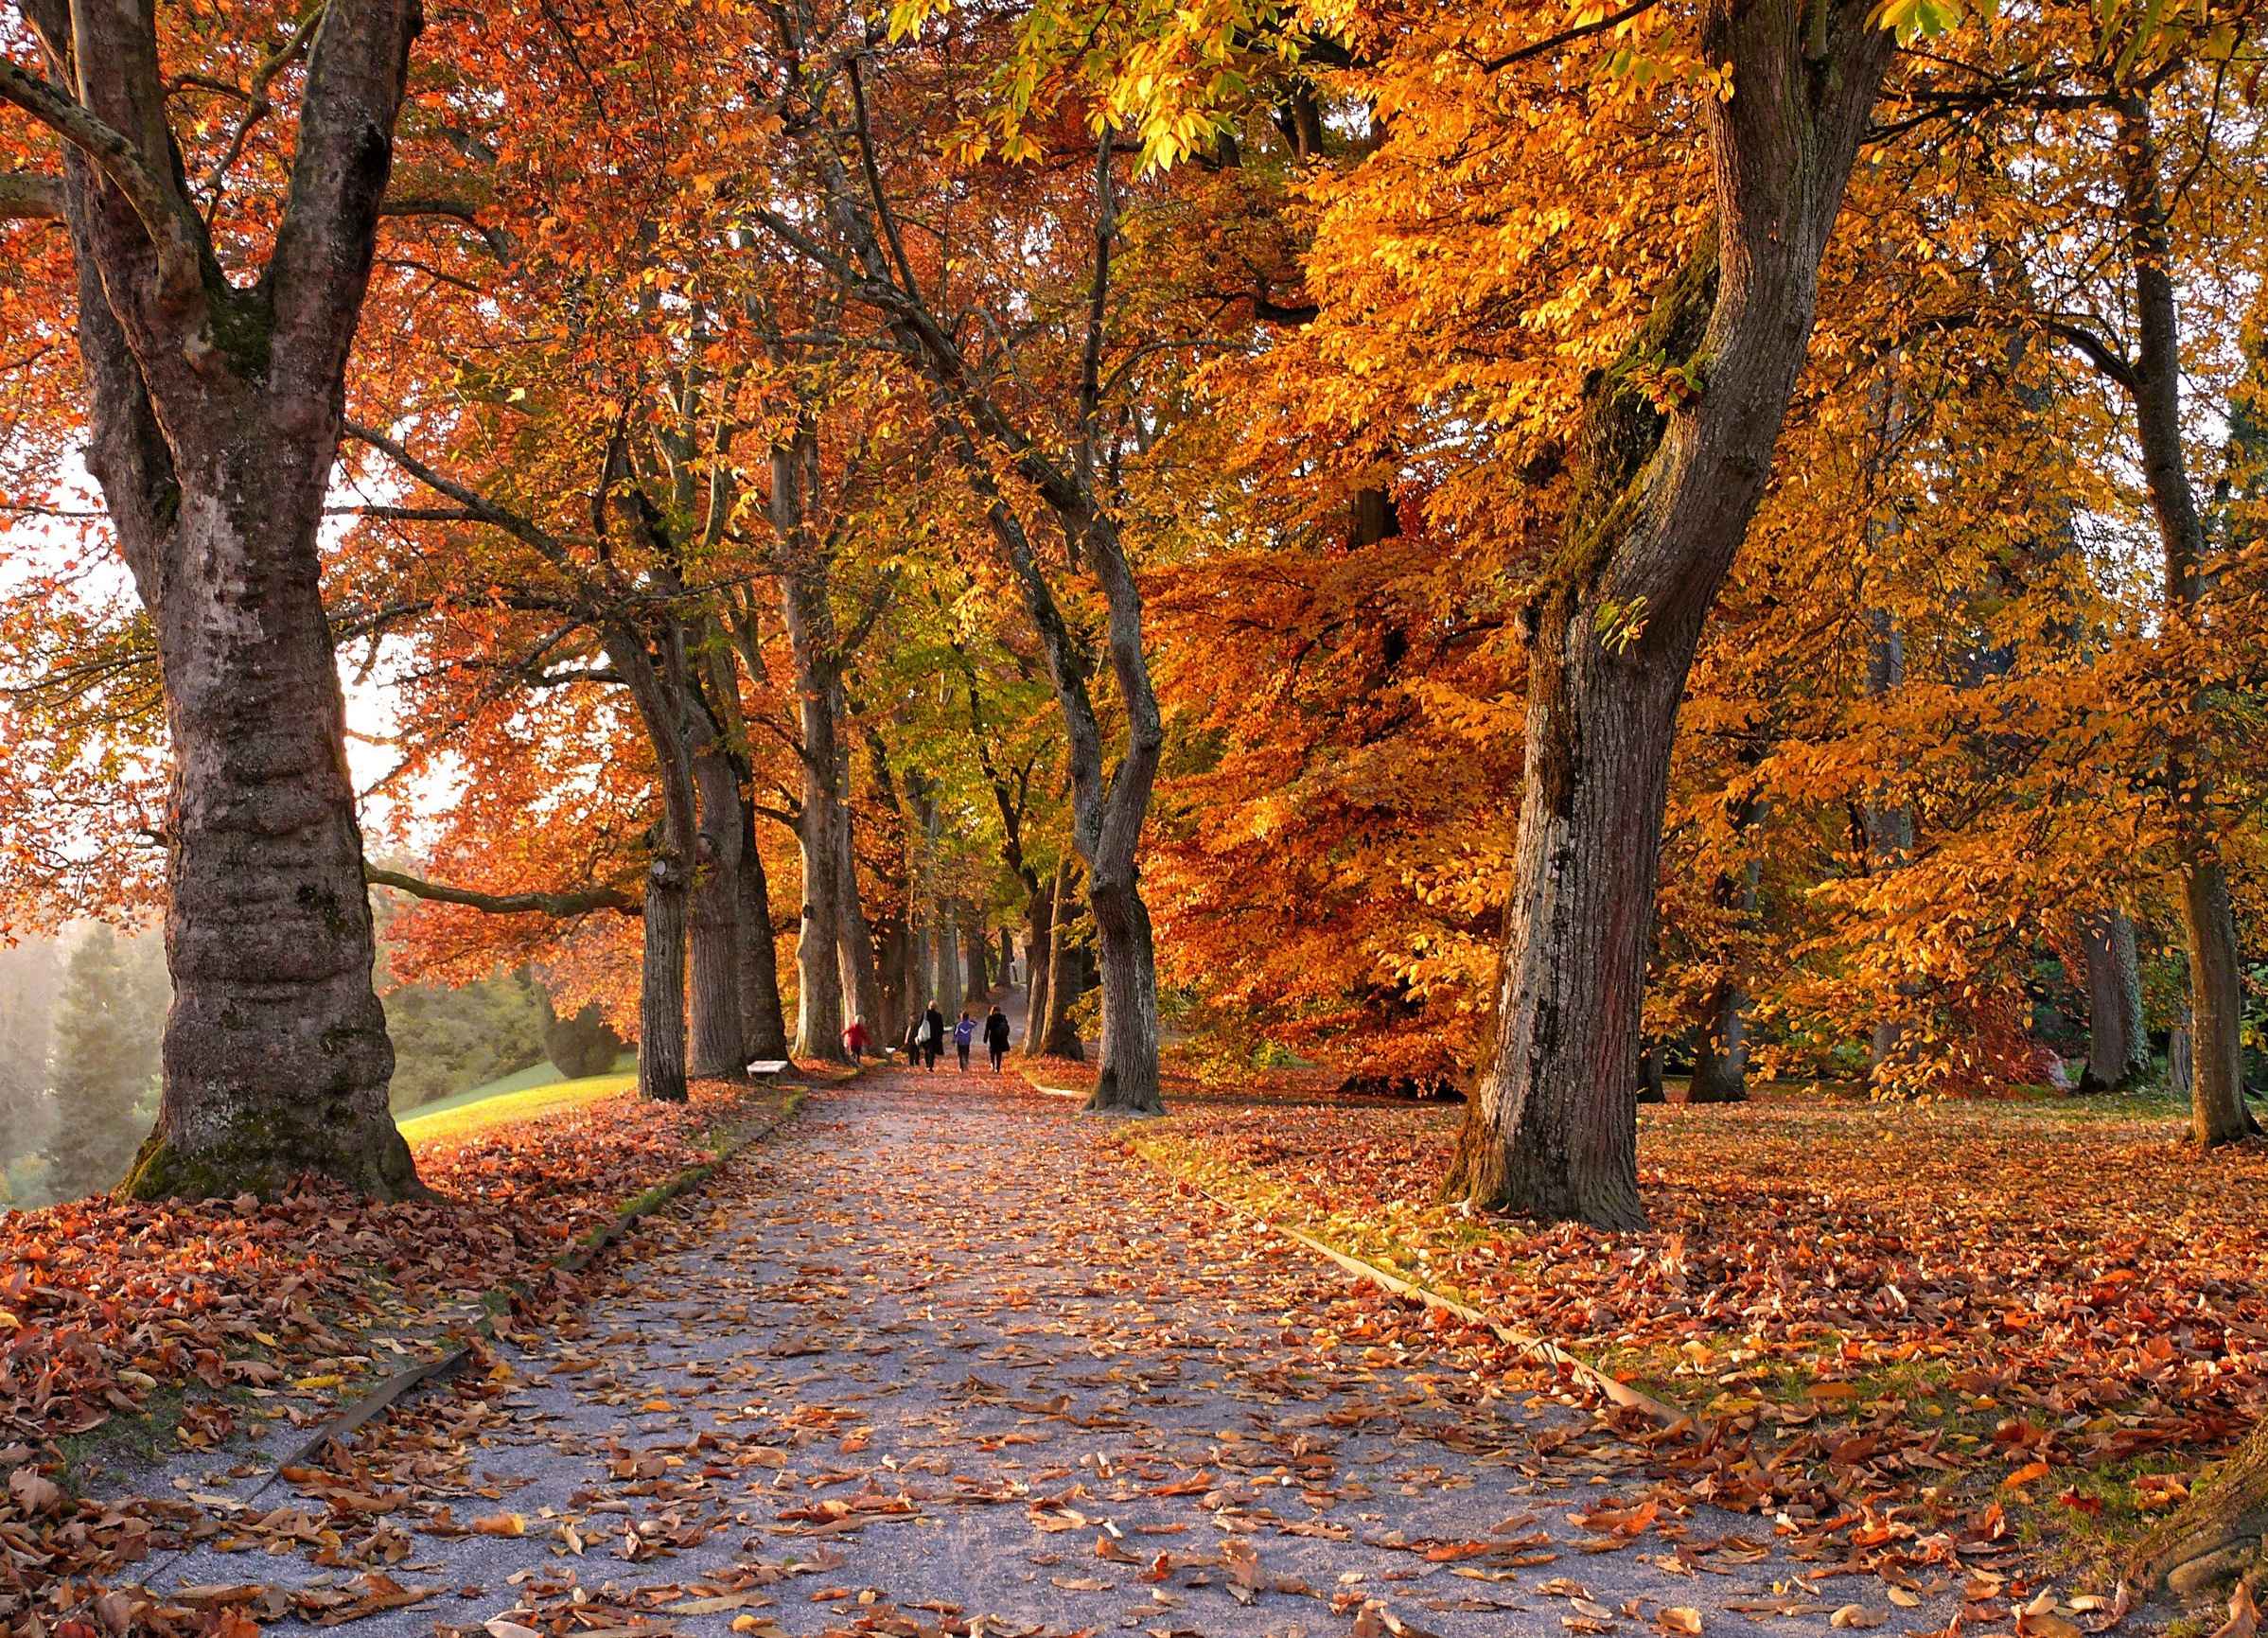
KEY FEATURES
Climate Dashboard: Visualize essential climate data with our intuitive dashboard.
Prediction Tools: Input various factors to see how they may affect future climate scenarios.
Educational Resources: Access articles, infographics, and resources to deepen your understanding of climate science.
Together, we can make a difference! Start your journey towards a more sustainable future today.

Slide 13
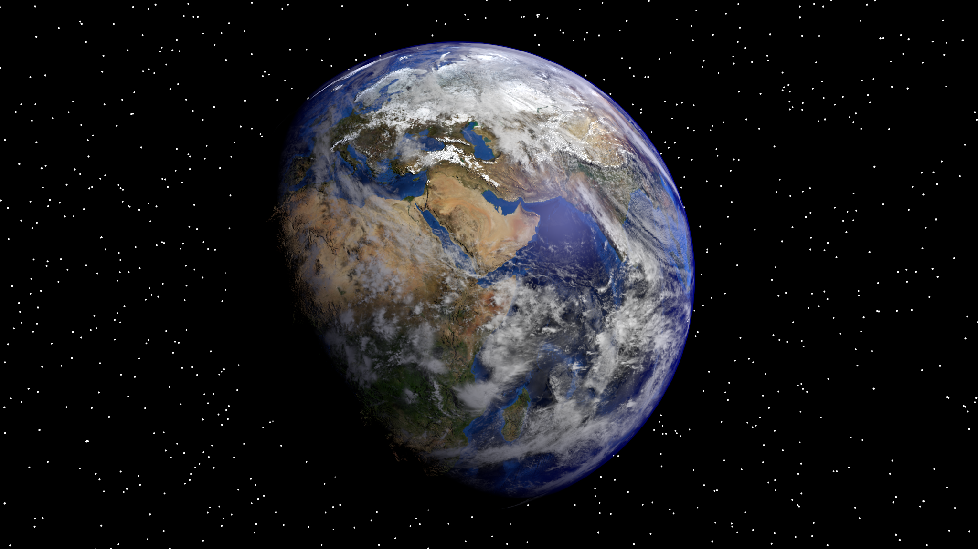
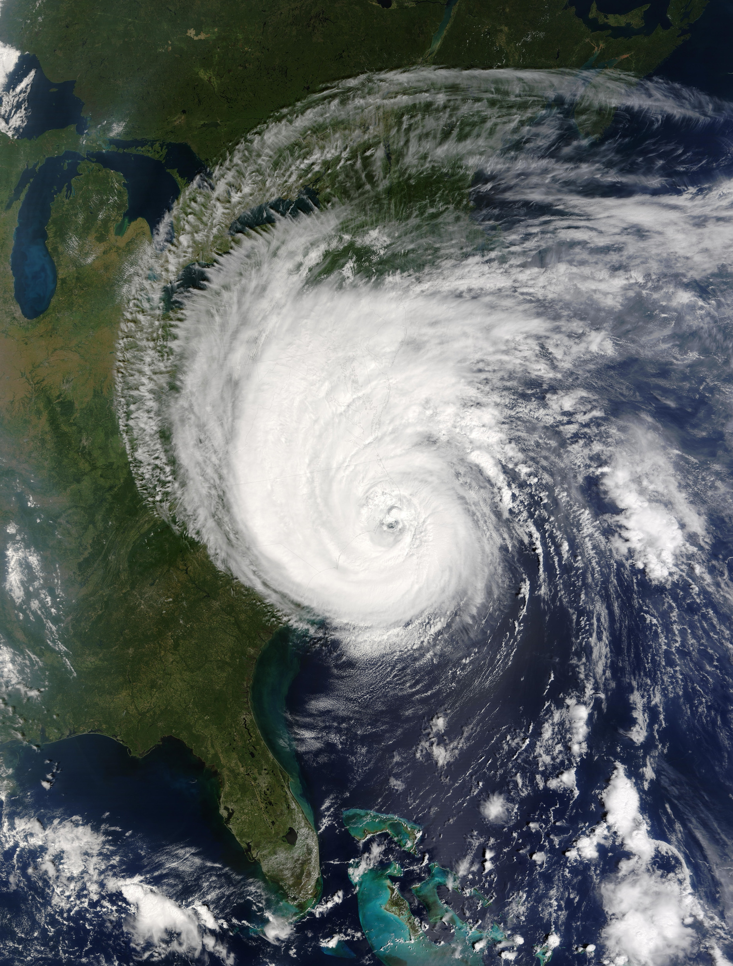
THANK YOU!
PREDATORS

